Slide 1
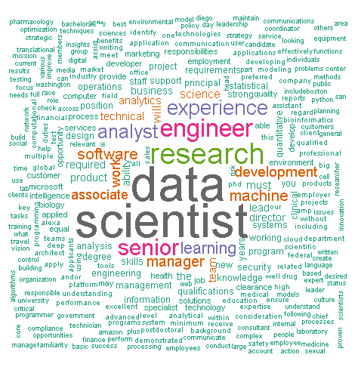
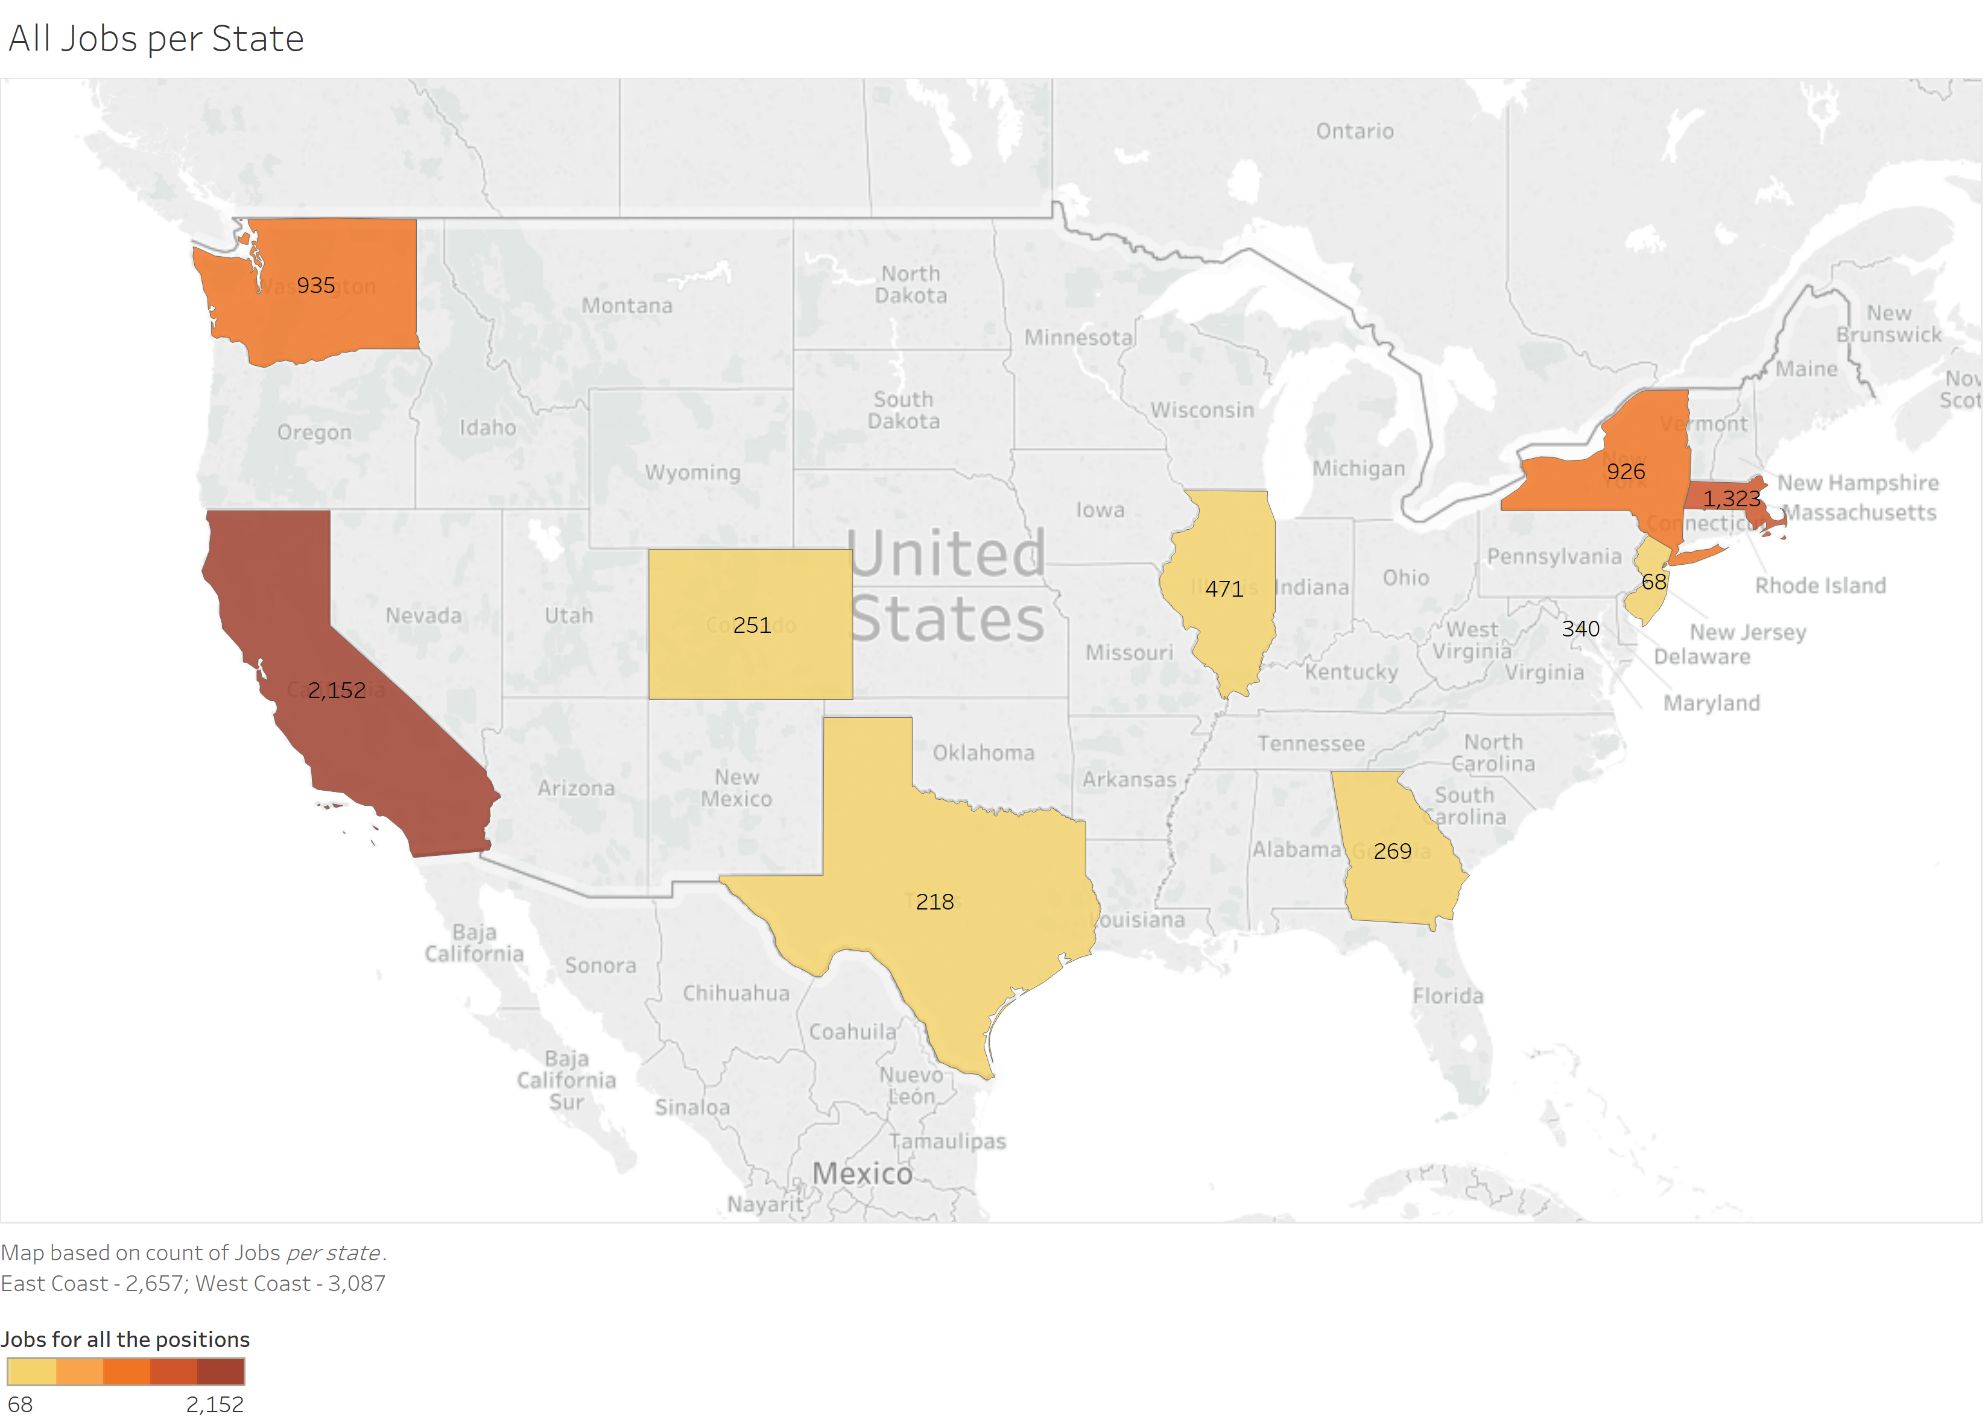
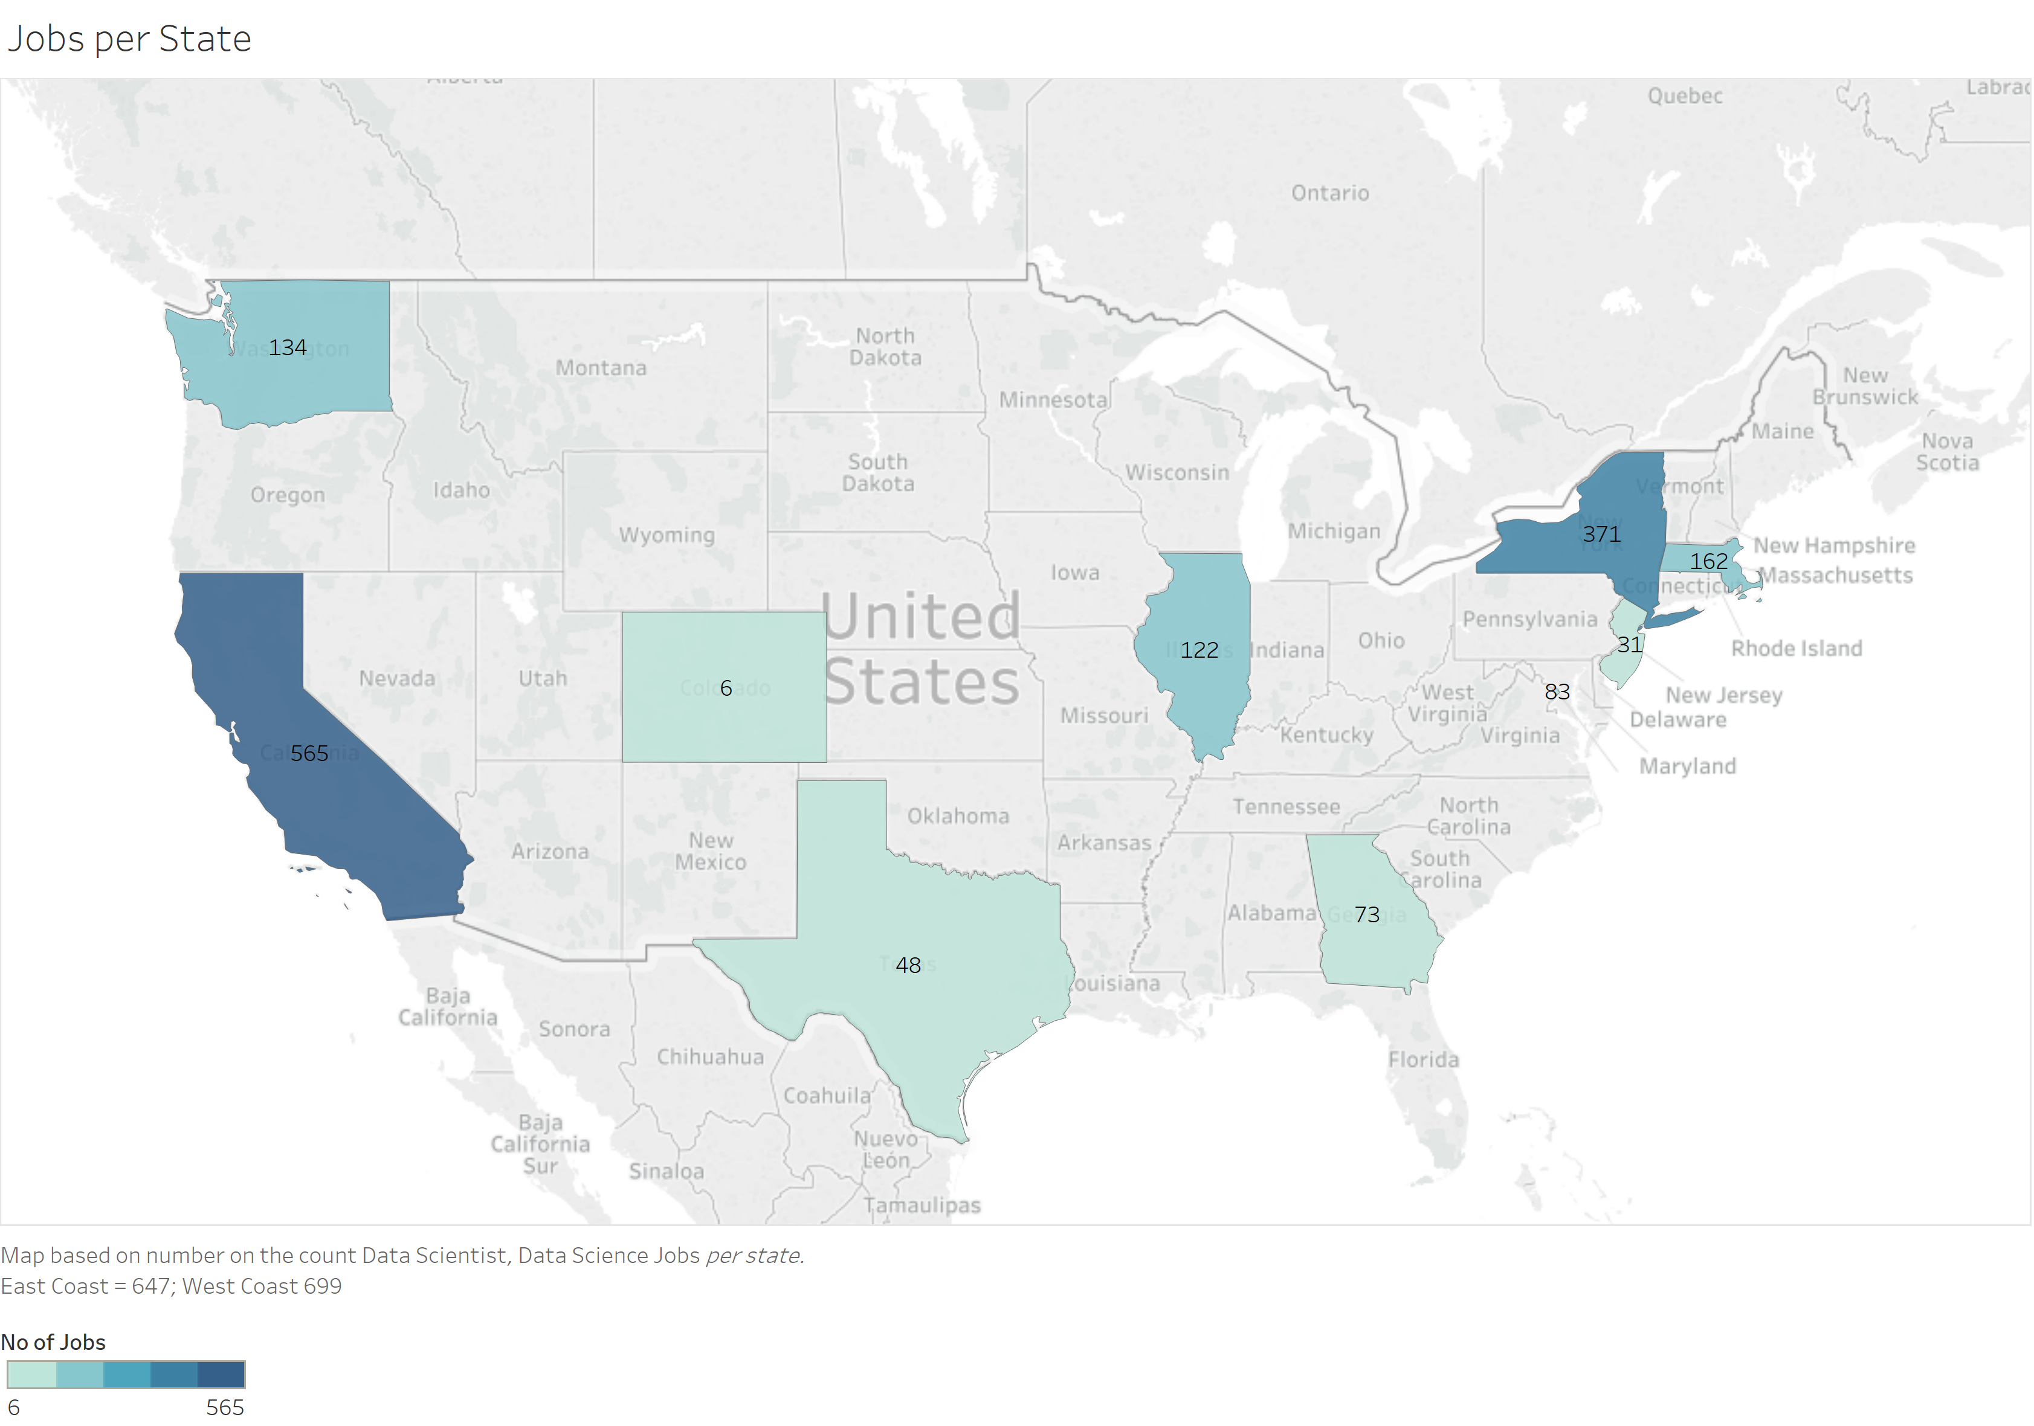
Figure 1: Word Cloud of the most recurring words in dataset
Figure 2: Jobs available in the whole dataset
Figure 3: Only Data Scientist and Data Science Jobs

Slide 2
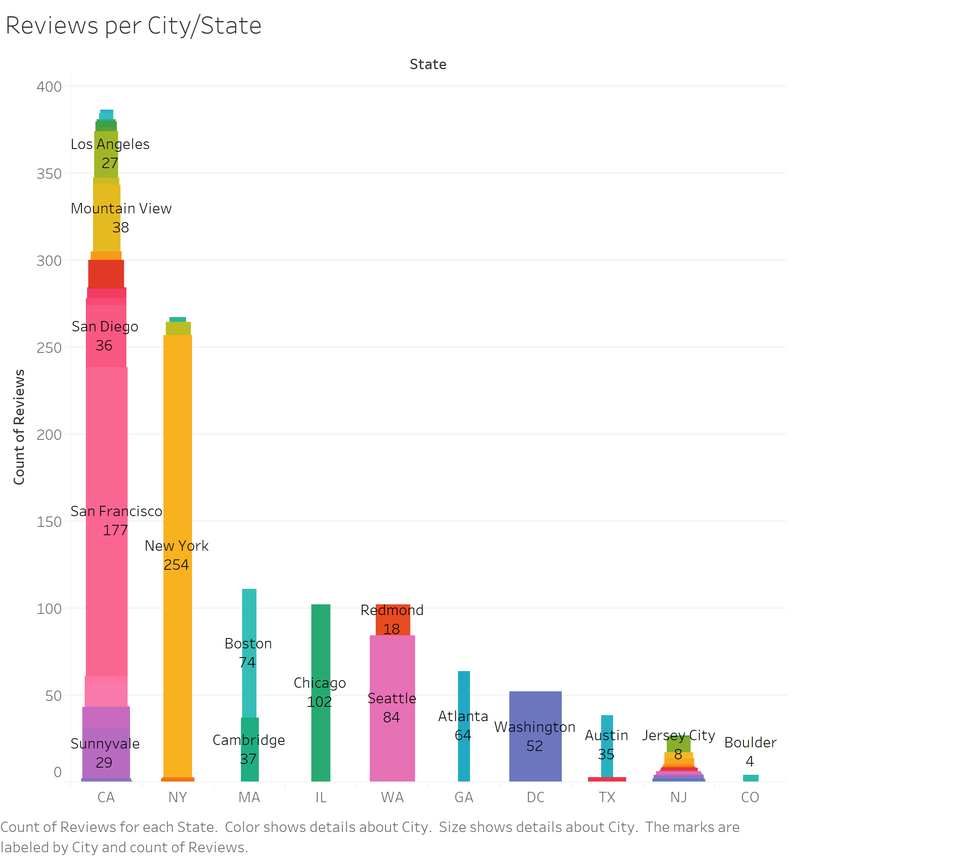
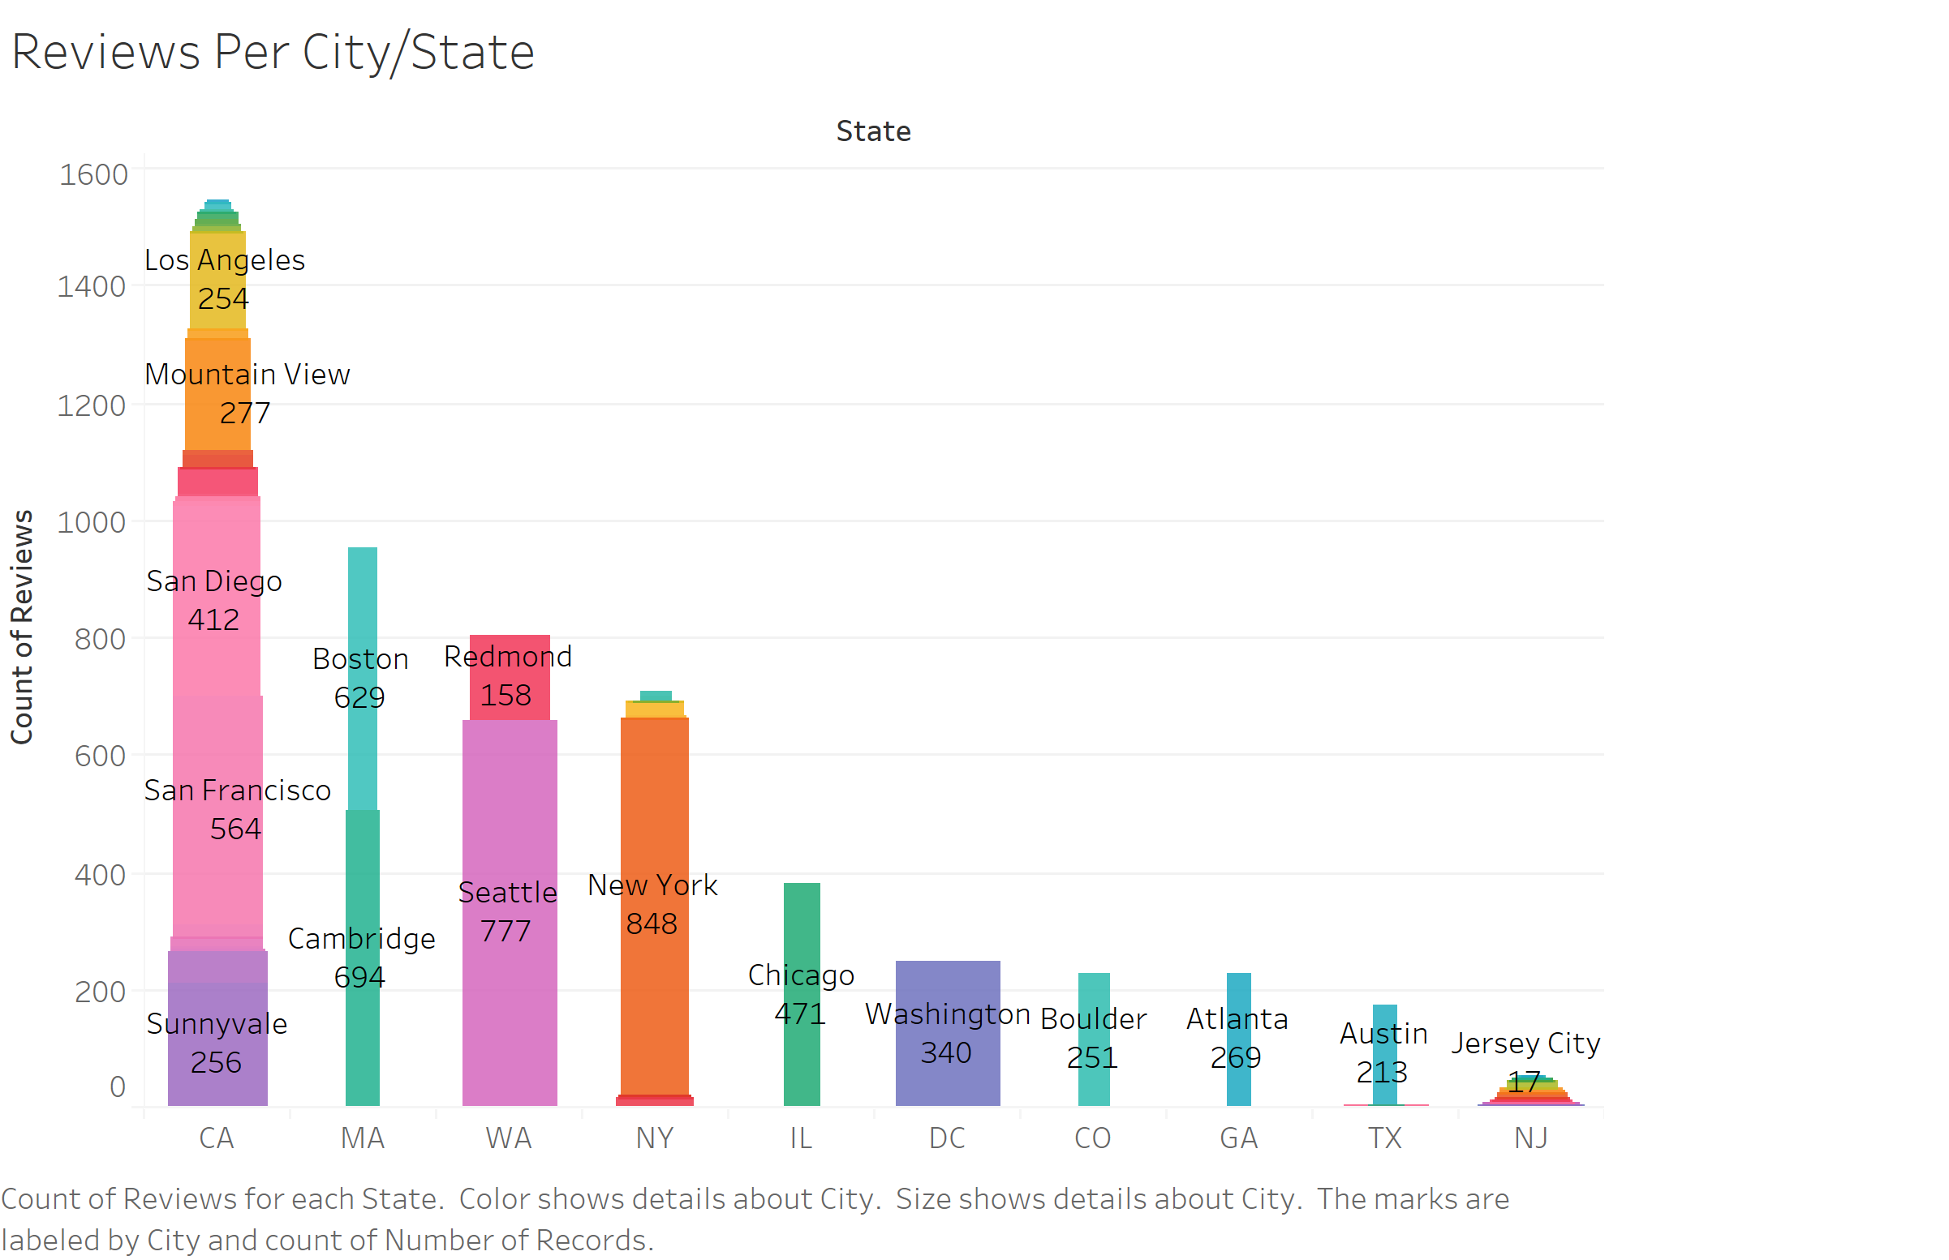
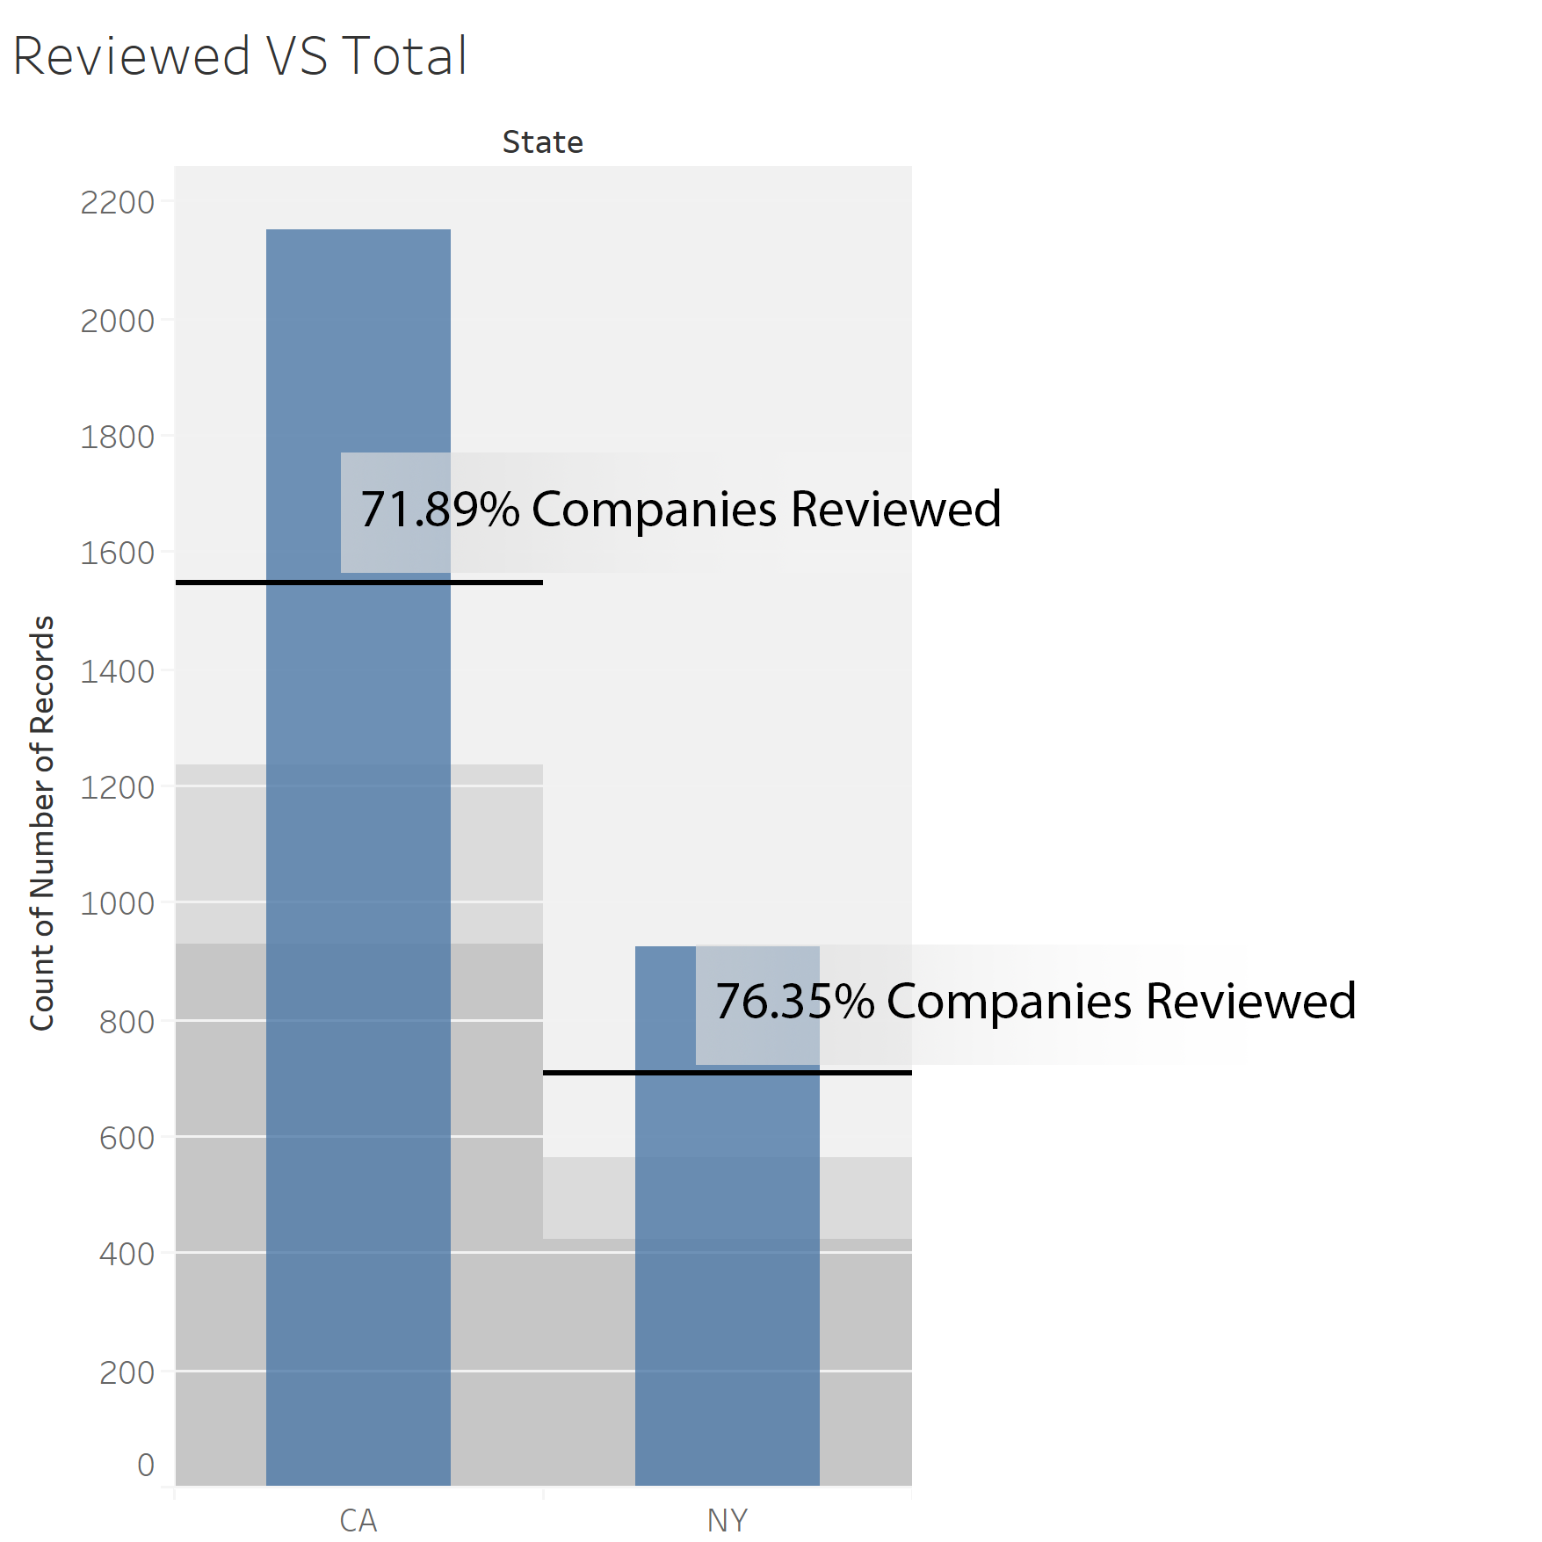
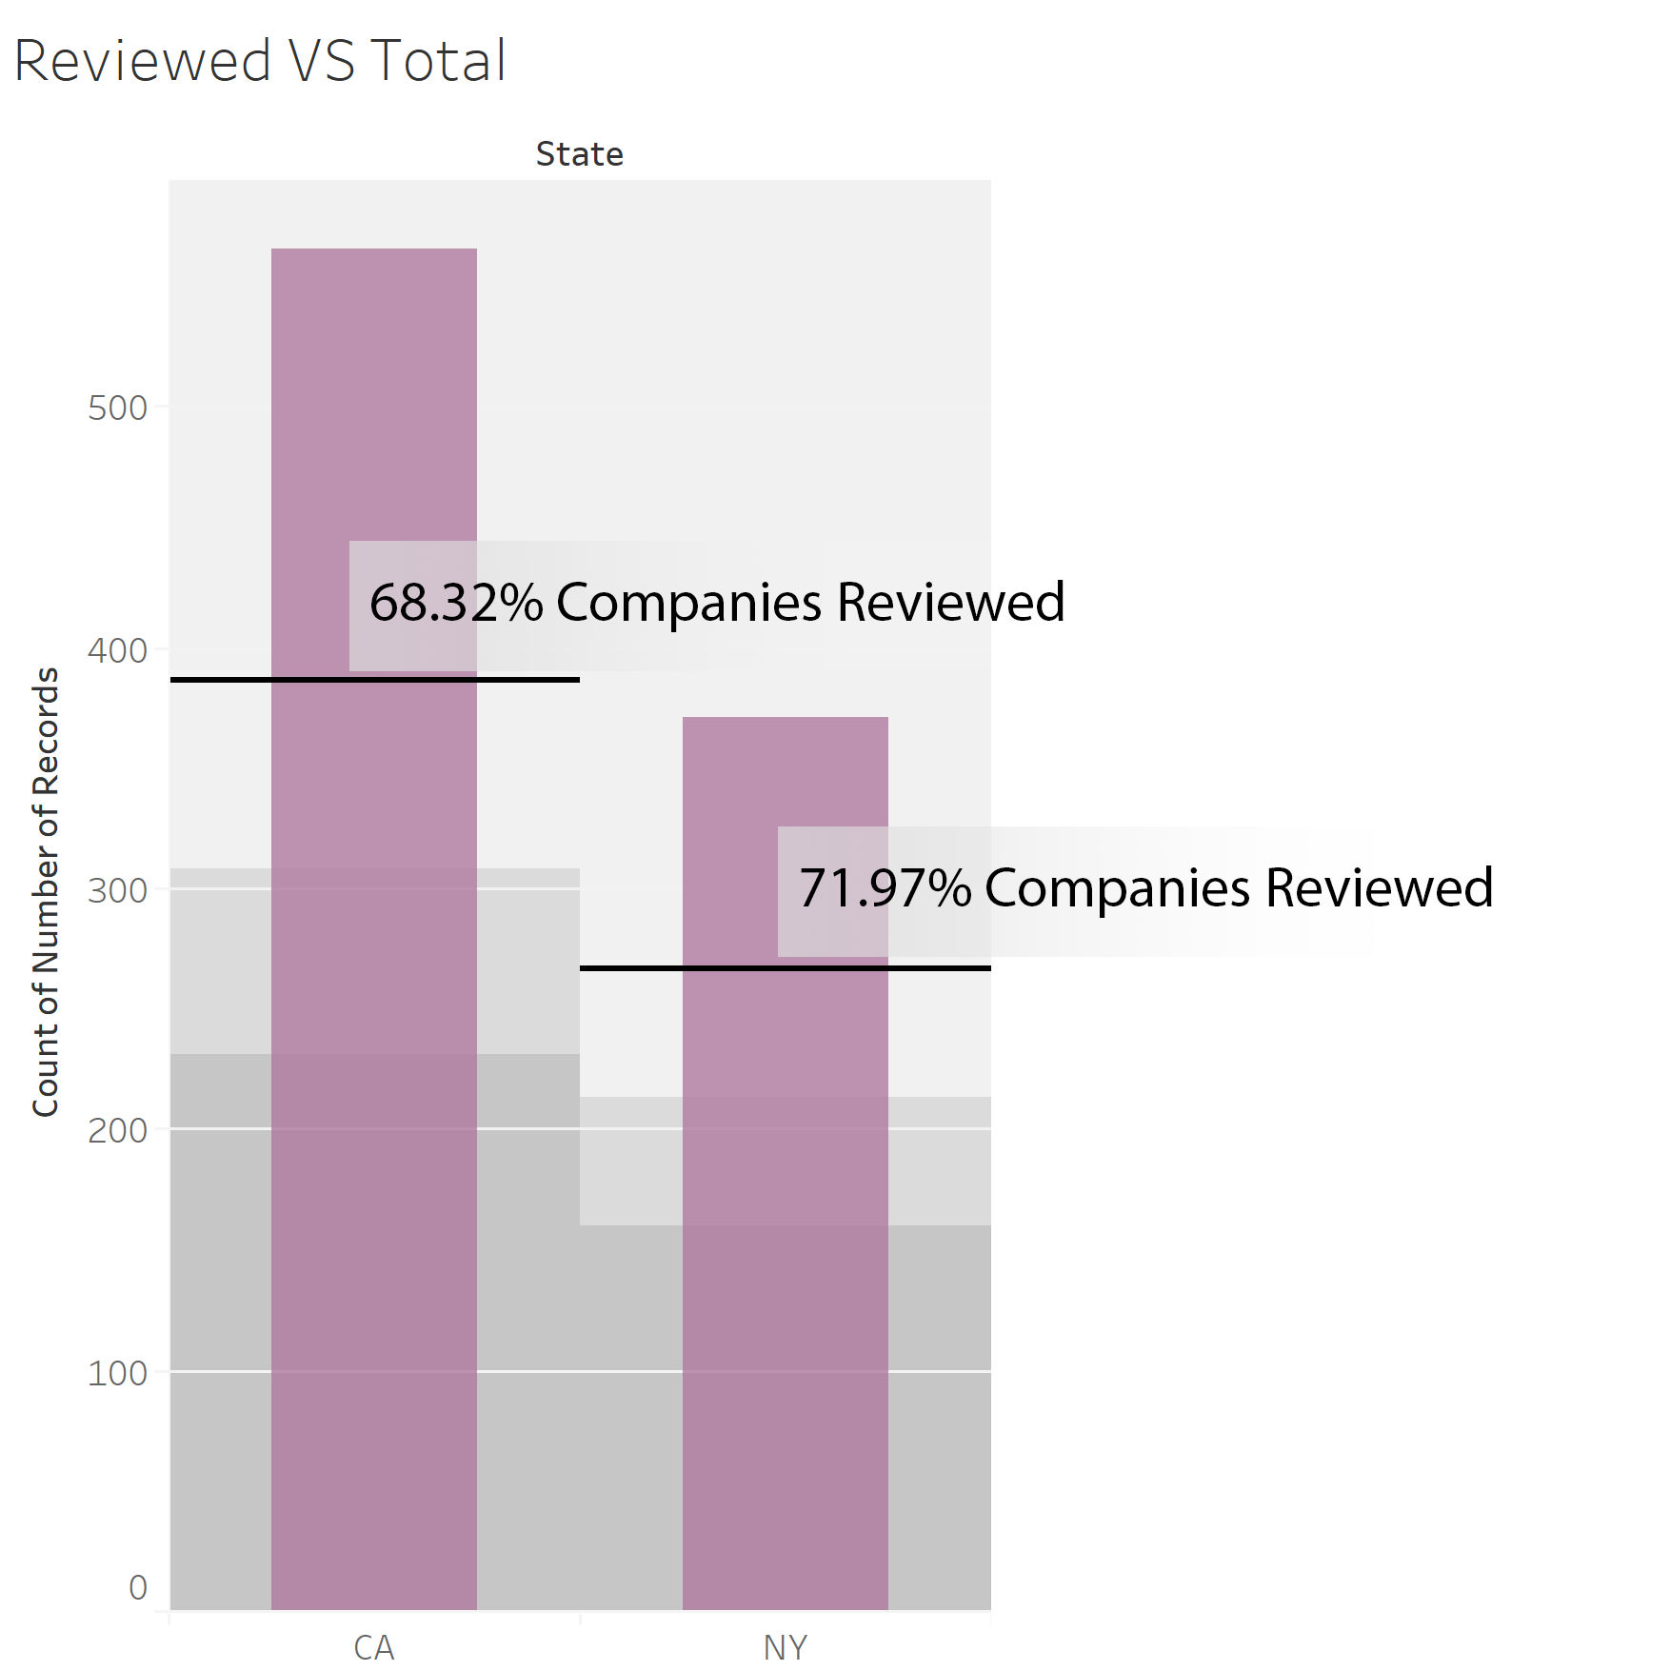
Figure 4: Reviews per city (Data Science)
Figure 5: Reviews per city (dataset)
Figure 6: Reviews per job (Data Science)
Figure 7: Reviews per city (dataset)

Slide 3
Thank you
Group members:
Nikhil Gawari, Nishit Parmar & Rushabh Barbhaya

